Slide 1

SOCIAL DISTANCING PREDICTION USING OpenCV
Batch-No :17
Presented By:
18RJ1A0508 : B.VAMSHI KRISHNA
18RJ1A0525 : K.PRABHU TEJA
16RJ1A0582 : J.V.S THARUN
Under the Guidance of :
B.Tirupathi Kumar

Slide 2
CONTENTS
ABSTRACT
PROBLEM DEFINITION
EXISTING SYSTEM
DISADVANTAGES
PROPOSED SYSTEM
ADVANTAGES
SYSTEM ARCHITECTURE
SYSTEM REQUIREMENTS
ALGORITHMS
MODULES
SCREENSHOTS
CONCLUSION
FUTURE ENHANCEMENT

Slide 3
ABSTRACT
The rampant coronavirus disease 2019 (COVID-19) has brought global crisis with its deadly spread to more than 180 countries, and about 53.1CR confirmed cases along with 63L deaths globally as on JUNE 3, 2022.
Along with vaccinations ,social distancing is also way to fight against this pandemic.
Motivated by this notion ,this project proposes a deep learning based framework for automating the task of monitoring social distancing using surveillance video.
The proposed framework utilizes the YOLO v3 object detection model to segregate humans from the background and Deep sort approach to track the identified people with the help of bounding boxes and assigned IDs.

Slide 4
PROBLEM DEFINITION
COVID-19 belongs to the family of coronavirus caused diseases, initially reported at Wuhan, China, during late December 2020.
This research is aimed to support and mitigate the coronavirus pandemic and propose a solution to detect the social distancing among people gathered at any public place.
The word “social distancing” is best practice in the direction of efforts through a variety of means, aiming to minimize or interrupt the transmission of COVID-19.
It aims at reducing the physical contact between possibly infected individuals and healthy persons.

Slide 5
EXISTING SYSTEM
A recent study indicates that social distancing is an important containment measure and essential to prevent SARSCoV-2, because people with mild or
no symptoms may fortuitously carry corona infection and can infect others.
social distancing is the best way to reduce infectious physical contact, hence reduces the infection rate .
This reduced peak may surely match with the available healthcare infrastructure and help to offer better facilities to the patients battling against the coronavirus pandemic.

Slide 6
DISADVANTAGES
Respiratory diseases are infectious where the rate and mode of transmission of the causing virus are the most critical factors to be considered for the treatment or ways to stop the spread of the virus in the community.

Slide 7
PROPOSED SYSTEM
The proposed framework utilizes the YOLO v3 object detection model to segregate humans from the background and Deep sort approach to track the identified people with the help of bounding boxes and assigned IDs.
The results of the YOLO v3 model are further compared with other popular state-of-the-art models, e.g. faster region-based CNN (convolution neural network) and single shot detector (SSD) in terms of mean average precision (mAP), frames per second (FPS) and loss values defined by object classification and localization.
Later, the pairwise vectorized L2 norm is computed based on the three-dimensional feature space obtained by using the centroid coordinates and dimensions of the bounding box.

Slide 8
ADVANTAGES
It focused on crowd detection and person count by proposing multiple height homographs for head top detection and solved the occlusions problem associated with video surveillance related applications.

Slide 9
TEST CASES
SI.NO. | Test case no. | particulars | Expected output | Actual output | Result | Remarks
1. | currency_menu_001 | RUN | It should be open for upload currency dataset | It should be open for upload currency dataset | Pass | Tested successfully

Slide 10
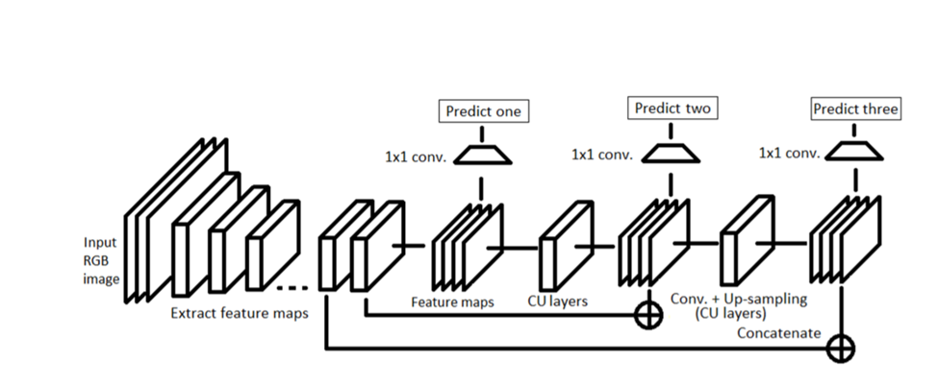
SYSTEM ARCHITECTURE

Slide 11
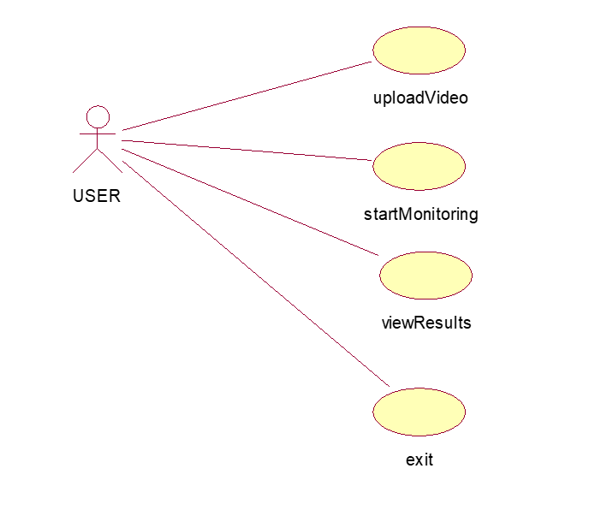
USE CASE DIAGRAM

Slide 12
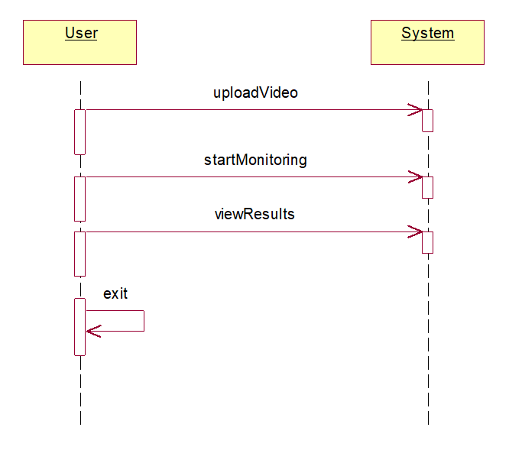
SEQUENCE DIAGRAM

Slide 13
MODULES
USER : The user monitors the distance between the people.
OpenCV :OpenCV is the huge open-source library for the computer vision, and one can process images and videos to identify objects, faces, or even handwriting of a human. when it integrated with various libraries, such as Numpuy , python is capable of processing the OpenCV array structure for analysis.

Slide 14
SYSTEM REQUIREMENTS
SOFTWARE REQUIREMENTS :
Operating System : Windows
Coding language : Python

Slide 15
HARDWARE REQUIREMENTS
System : Pentium IV 2.4 GHz.
Hard Disk : 40 GB.
RAM : 512 Mb.

Slide 16
ALGORITHM
YOLOv3 : It stands for you only look once,version3 is a real-time object detection algorithm that identifies specific objects in videos, live feeds, or images. YOLO uses features learned by a deep convolutional neural network to detect an object.

Slide 17
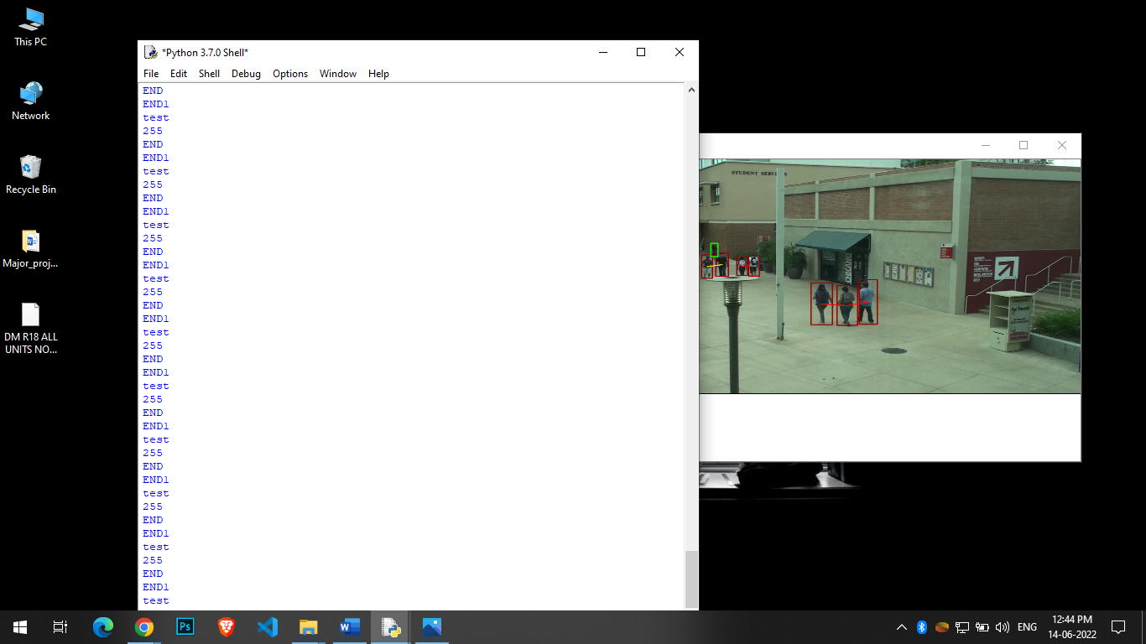
SCREENSHOT NO:1

Slide 18
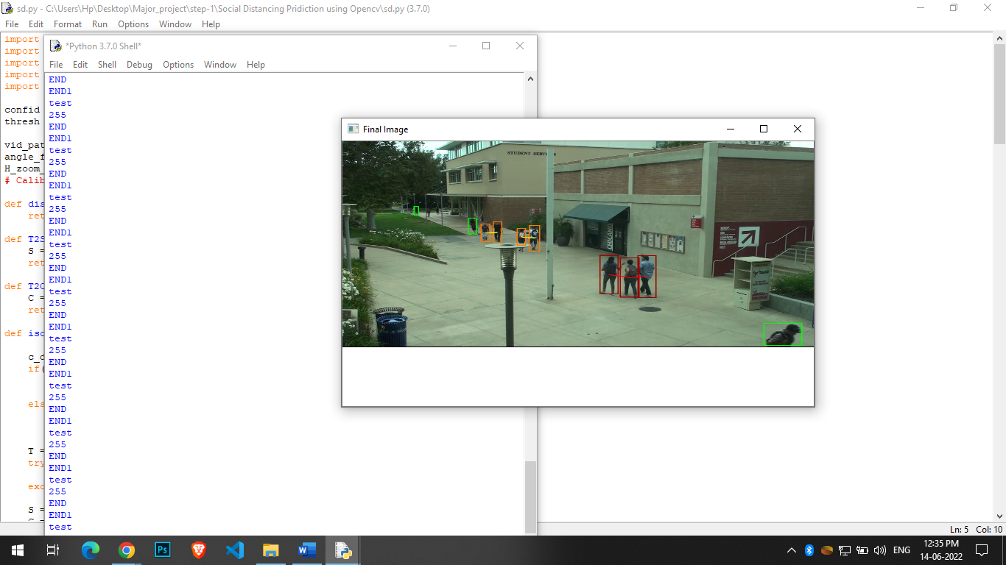
SCREENSHOTS NO:2

Slide 19
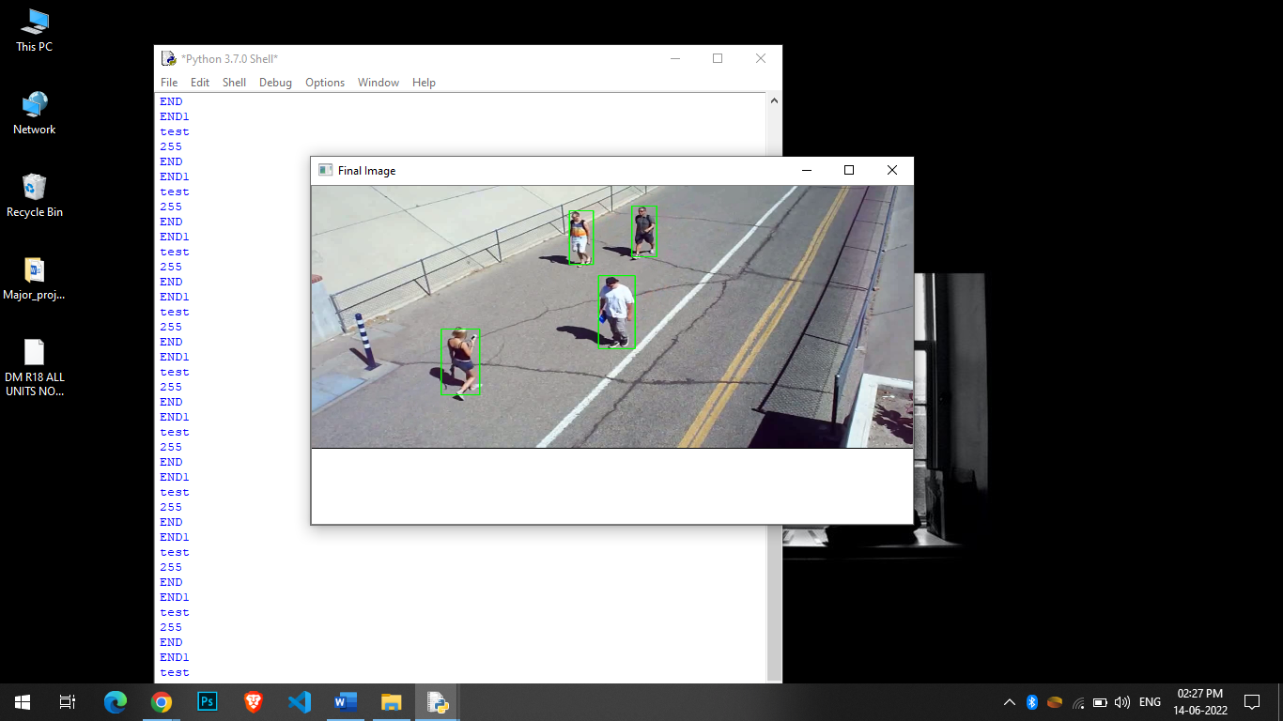
SCREENSHOTS NO:3

Slide 20
CONCUSION
An efficient real-time deep learning based framework to automate the process of monitoring the social distancing via object detection and tracking approaches, where each individual is identified in the real-time with the 9 help of bounding boxes.
The generated bounding boxes aid in identifying the clusters or groups of people satisfying the closeness property computed with the help of pairwise vectorized approach.
The extensive trials were conducted with popular state-of-the-art object detection models: Faster RCNN, SSD, and YOLO v3, where YOLO v3 illustrated the efficient performance with balanced FPS and mAP score.

Slide 21
FUTURE ENHANCEMENT
We can able to give the alert message to people .

